Slide 1
Contoso SharePoint Environment
The SharePoint Infrastructure

Slide 2
The Contoso Organisation
Deepak Singh
Sales & Marketing Manager
Amanda Harris
Human Resources Manager
Adam Smith
Regional South Manager
Vince Short
Regional South Manager
Carly Simon
Marketing Manager
Derek Hall
Learning & Development
Colin Harvey
Contracts Manager
Victoria Hughes
Recruitment Manager
Robert Small
Account Manager
Raquel Stevens
Account Manager
Denise Shields
Web Designer
Alan French
Finance Director
Ryan Stewart
Account Manager
Rajesh Shah
Account Manager
Daniella Flynn
Expenses Clerk
Colin Foster
Payroll Officer
Veronica Francis
Credit Controller
Rita Solomon
Account Manager
Rob Stone
Account Manager

Slide 3
SharePoint Web Structure
contoso-sp
:80
Contoso Central
:2010
Server Name
Web Applications
Site Collections
:101
Contoso Connect
Search Site
Project01 Project24 ProjectIns

Slide 4
Project xx & Project Instructor
Site Name: Projectxx (where xx is Student number 01 to 24 or ProjectIns for Instructor
URL: http://contoso-sp:2010/sites/projectxx
Site Type: Site Collection
Site Template: Team Site
1st Owner: Studentxx
2nd Owner: Instructor
Project Site Collection for all work performed by Student xx.

Slide 5
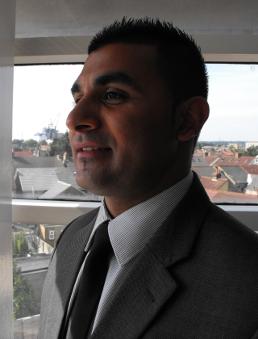
Deepak Singh
Job Title: Sales Director
Department: Sales & Marketing
E-mail: dsingh@xchg.com
Joined
Ask me about:
SharePoint Designer
SharePoint 2010

Slide 6
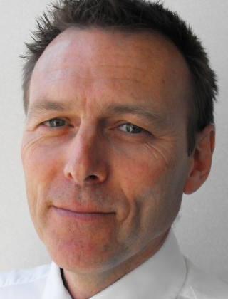
Adam Smith
Job Title: Regional South Manager
Department: Sales & Marketing
E-mail: asmith@xchg.com
Ask me about:
SharePoint Designer
SharePoint 2010

